Slide 1
The Library Management Sysrem
Group 6
Team work 1

Slide 2
Group Member
A10523006 Maggie
A10523049 Peggy
B10423003 Kurumi
B10423029 Bean
B10523020 Kendy
B10523030 Jerry
B10523053 Lynn
M10723001 Joe

Slide 3
Use Case Diagram

Slide 4
Introduction
Our subject, The Library Management System, is mainly for the problems
or functions you might meet or use when you are at the library.
Regarding using the library’s website,
we excluded the cases outside the library.
And we focus on book, ignore other objects’ situations.

Slide 5
Use Case Diagram

Slide 6
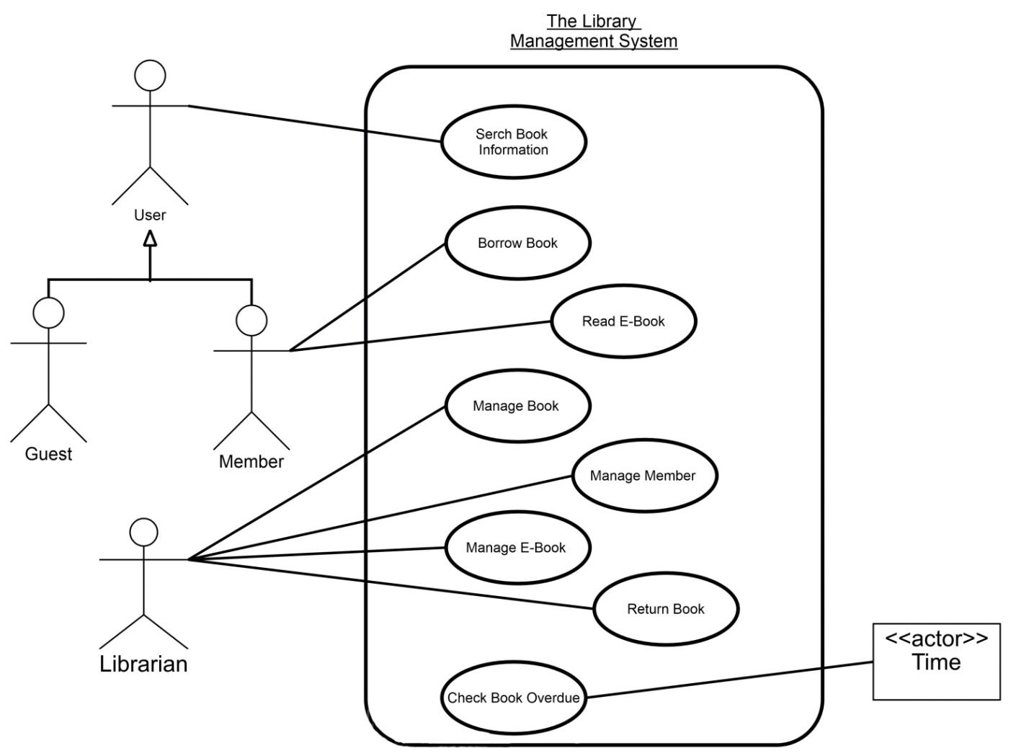
Use Case Diagram [ Search Book ]

Slide 7
Use Case Description

Slide 8
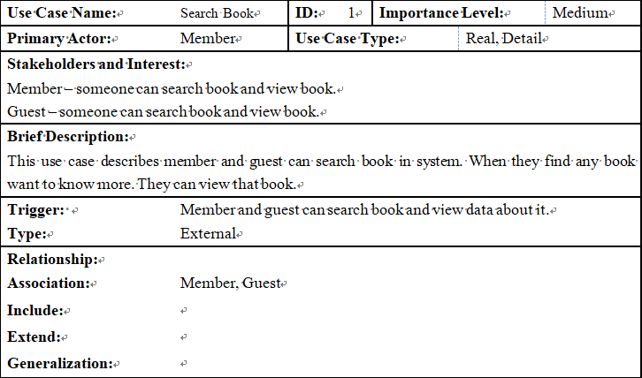
Use Case Description [ Search Book ]

Slide 9
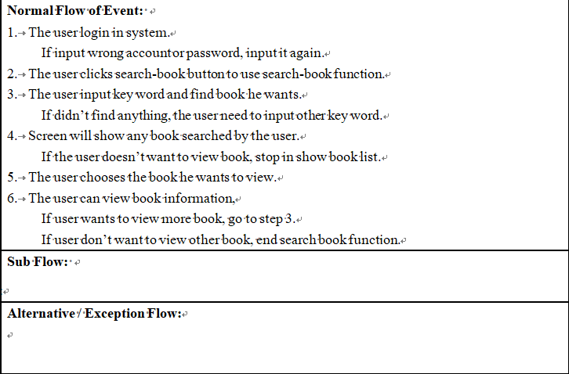
Use Case Description [ Search Book ]

Slide 10
Activity Diagram

Slide 11
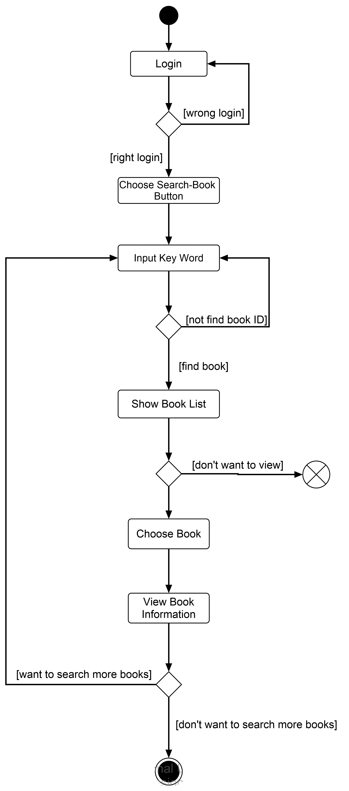
Activity Diagram [ Search Book ]

Slide 12
Sequence Diagram

Slide 13
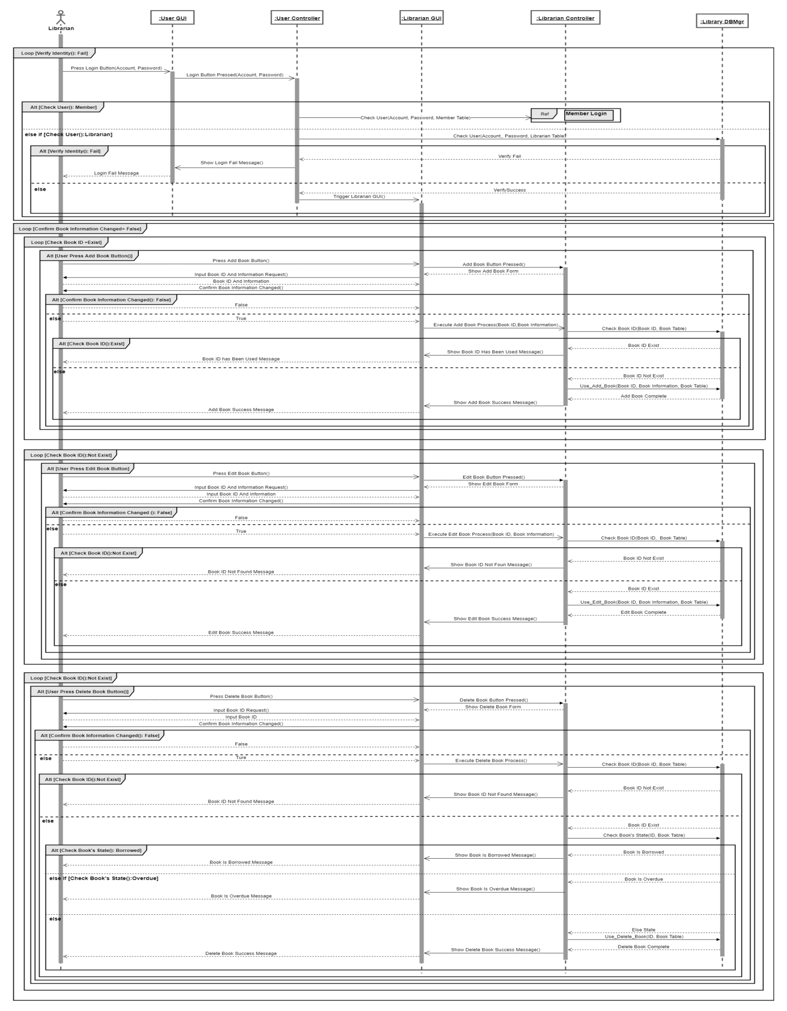
Sequence Diagram [Step 1]

Slide 14
Sequence Diagram [Step 2]

Slide 15
Sequence Diagram [Step 3]

Slide 16
Class Diagram

Slide 17
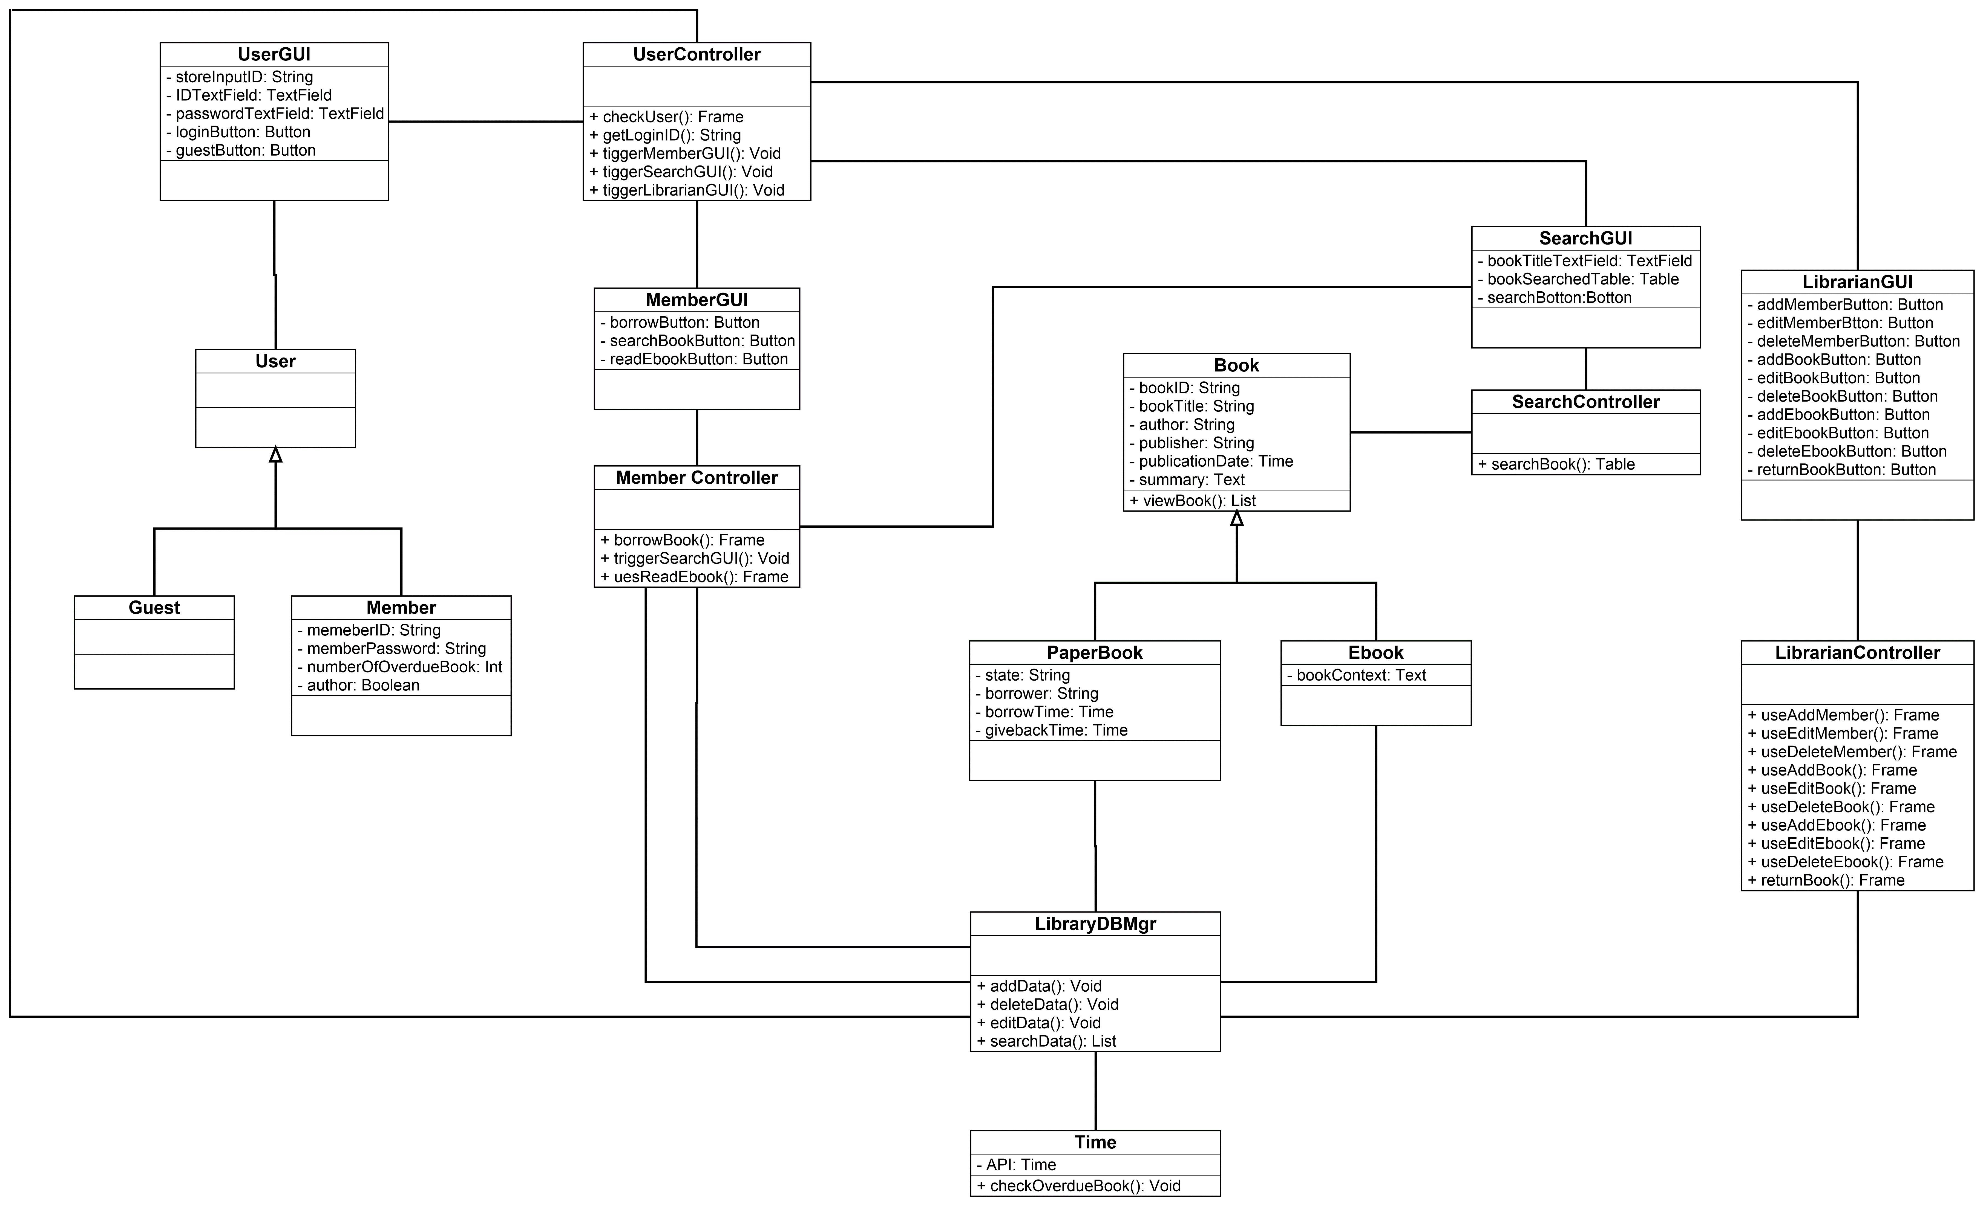
Class Diagram
Class Diaram

Slide 18
Behavior State Machine

Slide 19
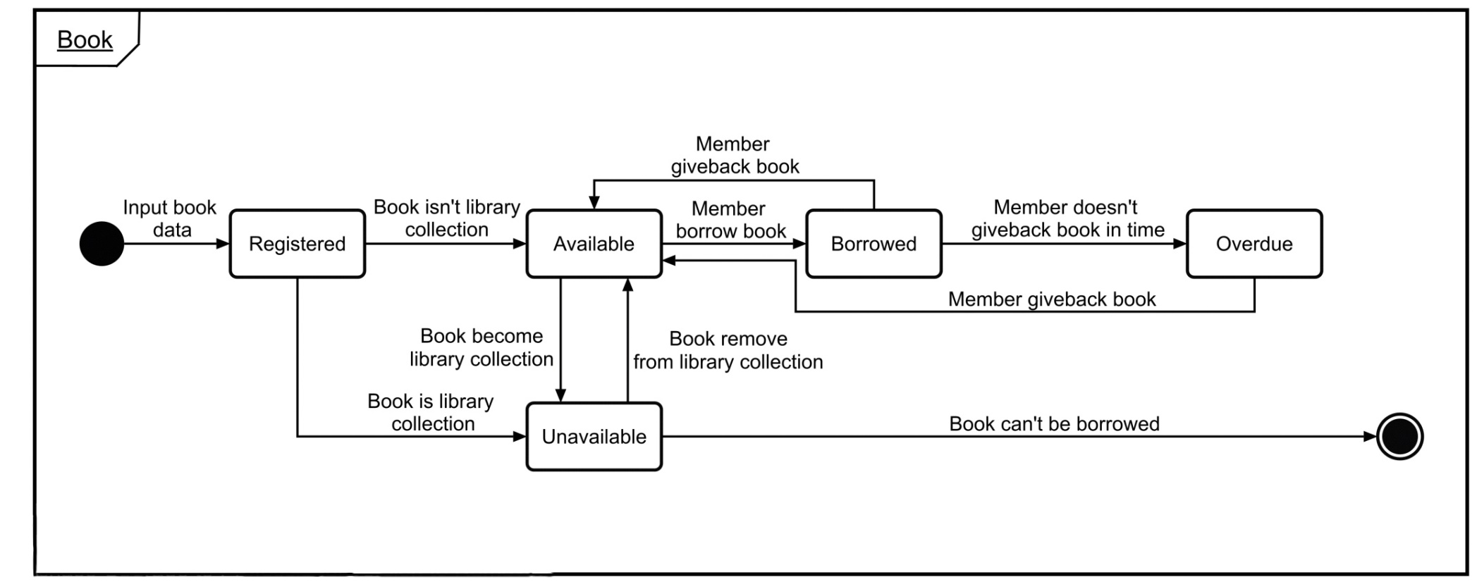
Behavior State Machine
[ Book ]

Slide 20
Thank you!
Group 6

